Slide 1
Genetics/th. Class MENDELIAN GENETICS
Lecture 0ne

Slide 2
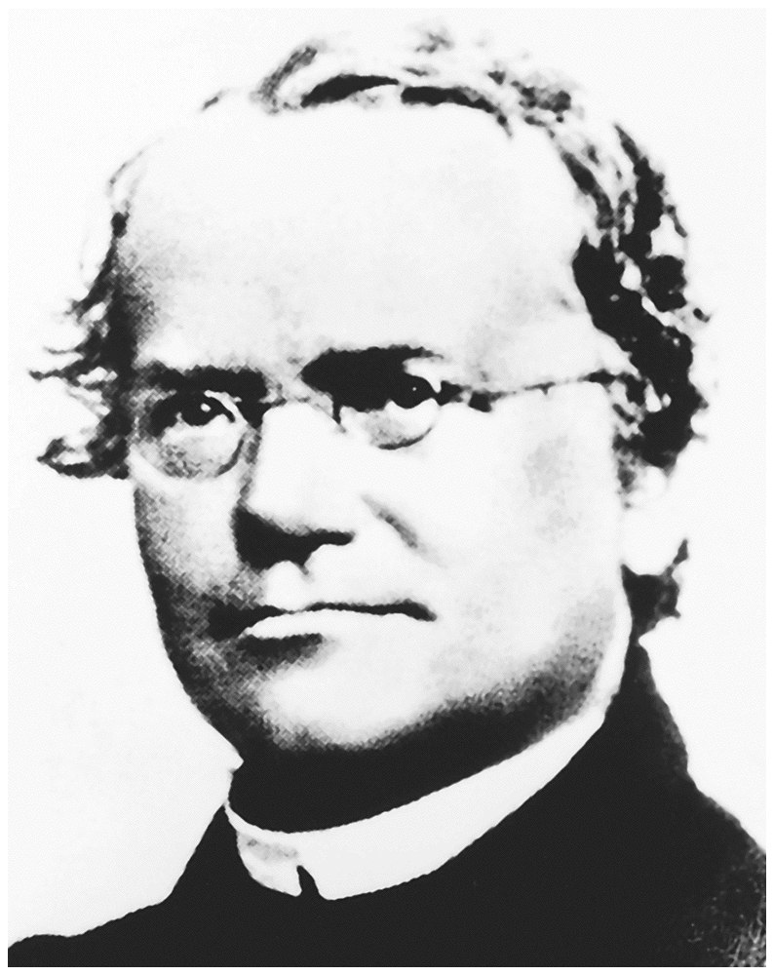
Gregor Mendel

Slide 3
Gregor Johann Mendel
Austrian monk
Studied the inheritance of traits in pea plants
Developed the laws of inheritance
Mendel's work was not recognized until the Between 1856 and 1863, Mendel cultivated and tested some 28,000 pea plants
He found that the plants' offspring retained traits of the parents
Called the “Father of Genetics"
turn of the 20th century

Slide 4
Mendel was the first biologist to use Mathematics – to explain his results quantitatively.
Mendel predicted
The concept of genes
That genes occur in pairs
That one gene of each pair is present in the gametes

Slide 5
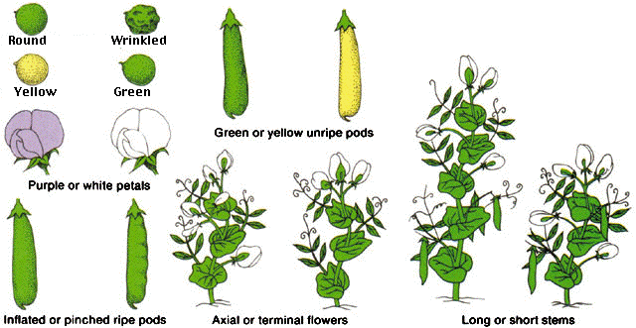
Mendel looked at seven traits or characteristics of pea plants:

Slide 6
Homozygous – having identical genes (one from each parent) for a particular characteristic.
Heterozygous – having two different genes for a particular characteristic.
Dominant – the allele of a gene that masks or suppresses the expression of an alternate allele; the trait appears in the heterozygous condition.
Recessive – an allele that is masked by a dominant allele; does not appear in the heterozygous condition, only in homozygous.

Slide 7
Genotype – the genetic makeup of an organisms
Phenotype – the physical appearance
of an organism (Genotype + environment)
Monohybrid cross: a genetic cross involving a single pair of genes (one trait); parents differ by a single trait.
P = Parental generation
F₁ = First filial generation; offspring from a genetic cross.
F₂ = Second filial generation of a genetic cross

Slide 9
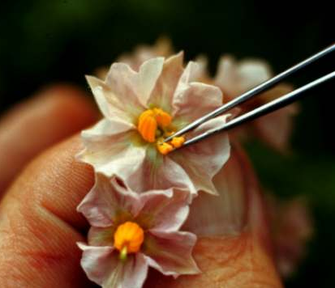
Mendel hand-pollinated flowers using a paintbrush
He could snip the stamens to
prevent self-pollination
Covered each flower
with a cloth bag
He traced traits through
the several generations

Slide 10
Generation “Gap”
Parental P₁ Generation = the parental generation in a breeding experiment.
F₁ generation = the first-generation offspring in a breeding experiment. (1st filial generation)
From breeding individuals from the P₁ generation
F₂ generation = the second-generation offspring in a breeding experiment. (2nd filial generation)
From breeding individuals from the F₁ generation

Slide 11
Mendel’s two Laws
1. Law of segregation
The two alleles for a trait segregate during gamete formation and only one allele for a trait is carried in a gamete. The gametes combine at random
(In other words:A cell contains two copies of a particular gene, they separate when a gamete is made).
2. Law of Independent Assortment
Alleles from one trait behave independently from alleles for another trait. Traits are inherited independently from one another

Slide 12
Law of Dominance

Slide 13
Monohybrid cross
Parents differ by a single trait.
Crossing two pea plants that differ in stem size, one tall one short
T = allele for Tall
t = allele for dwarf
TT = homozygous tall plant
t t = homozygous dwarf plant
T T × t t

Slide 14
P = parentals
true breeding,
homozygous plants
T T × t t
(tall) (dwarf)
T t
(all tall plants)
F₁ ₌ generation
is heterozygous

Slide 15
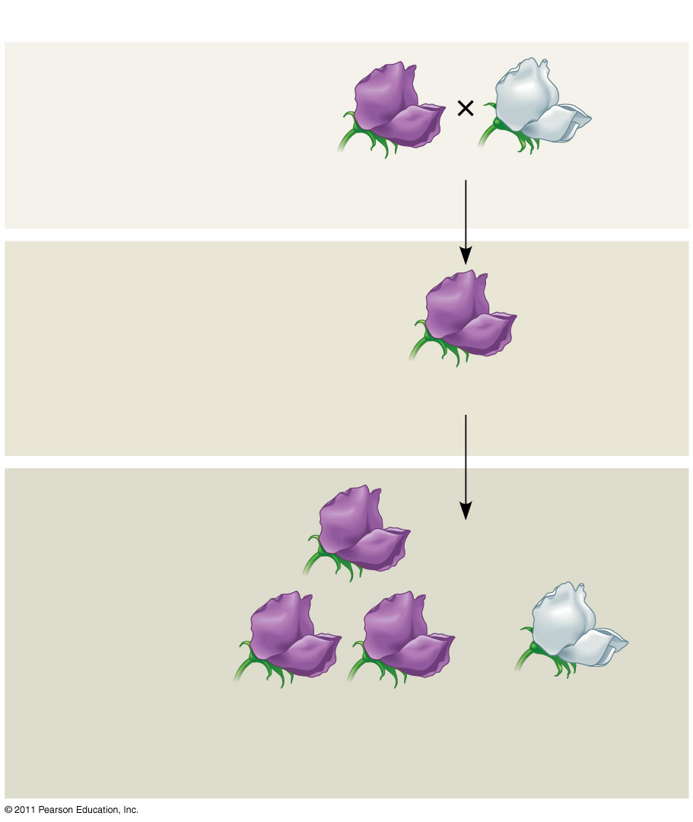
Purple flowers
White flowers
F₁ Generation
F2 Generation

Slide 16
A Dihybrid Cross - F₁ Results
aabb
AABB
AB
AB
ab
ab
AaBb

Slide 17
Test Cross
You cross an individual that shows the dominant phenotype with an individual with recessive phenotype ( one who is homozygous recessive for that trait)
Examining offspring allows you to determine the genotype of the dominant individual

Slide 18
Trait: Seed Shape Alleles: R – Round r – Wrinkled Cross: Wrinkled seeds x Hybrid
Round seeds = rr x Rr
Genotype: Rr, rr
Phenotype: Round & Wrinkled
G. Ratio: 1:1
P.Ratio: 1:1

Slide 19
F₂ Monohybrid Cross Review
Homozygous x heterozygous(hybrid)
Offspring: 50% Homozygous RR or rr 50% Heterozygous Rr
Phenotypic Ratio is 1:1
Called Test Cross because the offspring have SAME genotype as parents

Slide 20
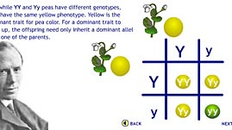
مربع بانيت

Slide 21
Non MENDELIAN GENETICS
Genetics/th. Class
Lecture Tow &Three

Slide 22
Mendel’s Laws Not Perfect:
Shortly people began to notice that not all traits are “Mendelian”
This means, they do NOT follow Mendel’s laws
Was he just plain wrong?
Truth is, his laws are correct and did explain how genetics works
Real life is just more complicated than peas!

Slide 23
Altering Mendel’s Ratios
Two different types of complications:
Genotypic ratios follow Mendel’s laws, but phenotypes do not
Somehow the underlying genotypic ratios are hidden
Mendel’s laws do not apply
Both genotypes and phenotypes are not following Mendel’s laws

Slide 24
Type 1 – Laws in effect:
Lethal genotypes
Allelic Heterogeneity
Incomplete dominance
Epitasis
Penetrance
Expressivity
Pleiotropy
Phenocopies
Genetic Heterogeneity

Slide 25
1. Lethal Genotypes
If a certain genotype (combination of alleles) causes death
Every genotype causes death if you wait long enough…
Usually stillbirth or miscarriage
Don’t ever see the phenotype
H
h
Expect to see 3:1 ratio
Instead see 100% dominant
H
HH
Hh
h
Hh
hh

Slide 26
2. Allelic Heterogeneity or multiple Allels
More than two alleles of the same gene
ex: Cystic Fibrosis has hundreds of alleles possible on the same gene
Causes differences in phenotype depending on which two alleles a person inherits
Still follow Mendel’s laws within one cross
Individual can only have two alleles (only have two chromosomes)
One inherited from mother, one from father

Slide 27
3. Incomplete Dominance
One allele is not completely dominant over the other
Causing the heterozygote to have a third, different phenotype
ex: Blending in flowers
Homo Dominant = red flowers
Homo recessive = white flowers
Heterozygotes = pink flowers

Slide 28
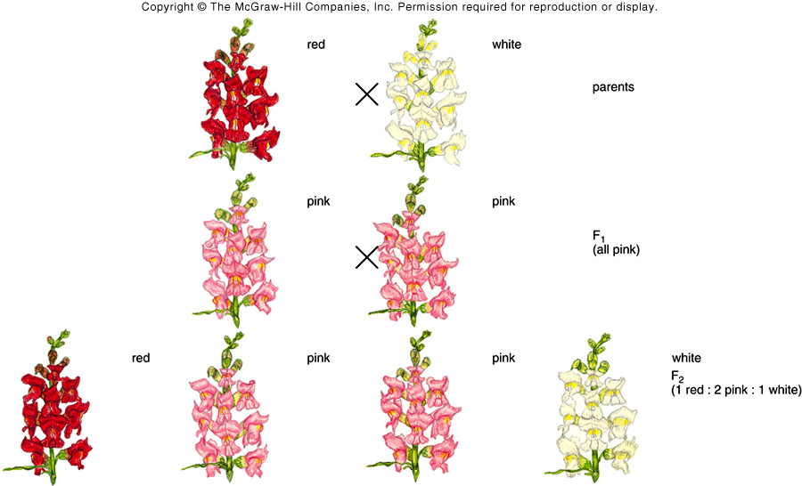
P1 ,F1,F2 Generation
Genotype: Rr Phenotype: Pink

Slide 29
3. Incomplete Dominance
ex: Blood Types
Type A = AA or Ao
Type B = BB or Bo
Type AB = AB (heterozygote)
Type O = oo (homozygous recessive)
Still following Mendel’s laws:
Two alleles per cross
1:2:1 genotypic ratios
Just not showing 3:1 phenotypic ratios

Slide 30
Definition
Two nonidentical alleles of a pair express two different phenotype in the heterozygote.
Example
1) Blood groups are controlled by three alleles
(multiple allele system).
a) I^{A}, I^{B}, i
2) Possible Outcomes
a) ii = O blood group
b) I^{A}I^{A} or I^{A}i = A blood group
c) I^{B}I^{B} or I^{B}i = B blood group
d) I^{A}I^{B} = AB blood group (Codominance)

Slide 31
4. Epistasis
Two genes interacting to affect phenotype
Therefore Mendel’s law about the one gene, is changed by the second gene
ex: Gene C controls the color of a person’s eyes
However gene A causes albinism (lack of any pigment anywhere in body)
Therefore if a person is carrying gene A it will not matter which genotype for gene C is carried (eyes will be red)

Slide 32
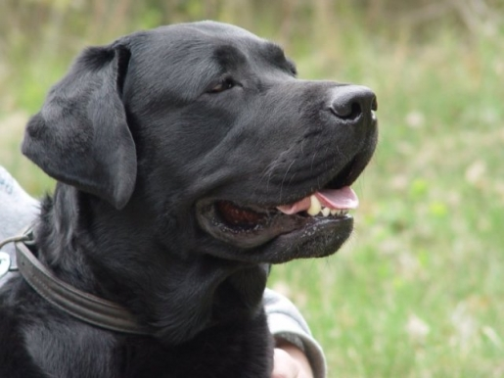
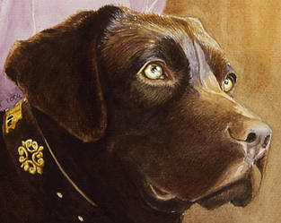
Brown Yellow Black
BBEE
BBee bbEE BbEE
Bbee bbEe BBEe
bbee BbEe

Slide 33
4. Epistasis
One gene effecting or masking another gene
or
Two genes controlling same phenotype
Mendel’s Laws are still working for each individual gene, but phenotype is not determined by that single gene’s genotype alone

Slide 34
5. Penetrance
Sometimes the same genotype will not produce the phenotype in all individuals
Penetrance = the percent of individuals who have a certain genotype and show the expected phenotype
Mendel traits penetrance = 100 %
Some traits penetrance is less than 100%

Slide 35
5. Penetrance
Decreased penetrance or “low penetrance” means that some people inherit genotype and yet do not show the phenotype
Penetrance is calculated as:
Number of individuals who have genotype and expected phenotype Total number of individuals who have genotype (any phenotype)
Usually decrease caused by interaction of additional genes or environment

Slide 36
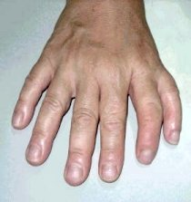
Penetrance (Expressivity)

Slide 37
6. Expressivity
Sometimes the same genotype will produce different “degrees” of phenotype in individuals
Expressivity = the severity or extent of the phenotype an individual shows
ex: Hypercholesterolemia
Some individuals have extremely high cholesterol from birth, others can control with diet and exercise and lead normal lives

Slide 38
Penetrance vs. Expressivity
Both follow Mendel’s laws
Genotypic ratio is still 1:2:1
Phenotypic ratio is affected
Both have to do with “amount” phenotype is present
Penetrance – is all or none, person is affected with disease or not
Expressivity – is the severity of the phenotype

Slide 39
7. Pleiotropy
One gene causes more than one phenotype
Pleiotropy occurs when one gene controls more than one pathway or is expressed in more than one body part
ex: One gene makes connective tissue
Needed for lens of eye
Heart Muscle

Slide 40
Therefore a mutation in this one gene will cause defects in eye sight, heart attacks, and weakness in muscles and limbs
Needed for lens of eye
Heart Muscle

Slide 41
8. Phenocopies
Trait is not genetic at all
An environmentally caused trait that appears to be genetic/inherited
or
An environmentally caused phenotype that is the same as an inherited phenotype
Not breaking any of Mendel’s laws because it’s not genetic!

Slide 42
Polygenic Inheritance
Definition
Continuous range of small differences in a given trait among all the individuals of a population due to inheritance of multiple alleles that affect the same trait.
Examples
1) Height
2) Eye color (4 Genes and 8 Alleles)

Slide 43
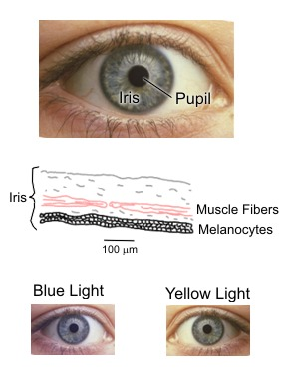
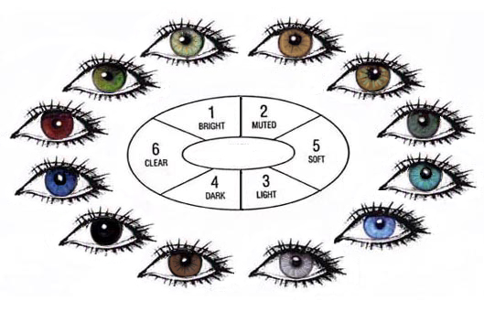
EYE COLOR

Slide 44
Polygenic Inheritance
Eye Color Alleles Alleles
Light Blue aabbccdd 0
Medium Blue aabbccDd 1
Dark Blue aabbCcDd 2
Gray aaBbCcDd 3
Green AaBbCcDd 4
Hazel AaBbCcDD 5
Light Brown AaBbCCDD 6
Medium Brown AaBBCCDD 7
Dark Brown AABBCCDD 8

Slide 45
Environmental Effects
Definition
The environment can affect the expression of a gene.
1) Example
Himalayan rabbits
a) Homozygous for c^{h} allele coding for tyrosinase expressing melanin production
b) Tyrosinase is not active above 33° C
c) Hair appears light due to lack of melanin

Slide 46
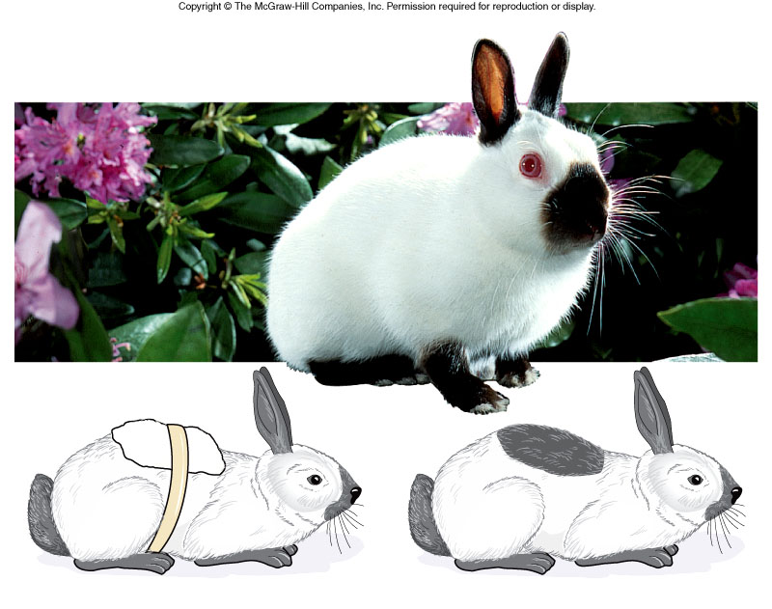

Slide 47
Type 2 – Mendel’s Laws No Longer Apply
Mitochondrial Inheritance
Mitochondria have their own DNA, which is solely maternally inherited
Linkage
Two genes that are close together physically
Linkage Disequilibrium
Two alleles that are not inherited separately

